Slide 1
Introduction To Machine Learning

Slide 2
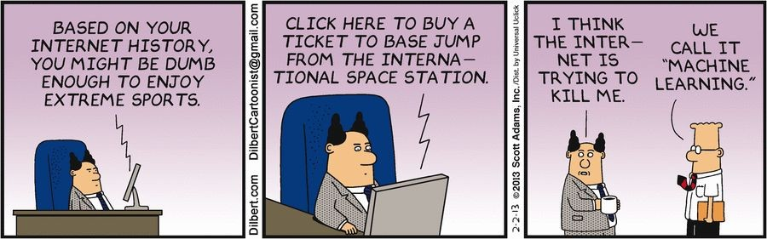

Slide 3
What is Machine Learning?
“Learning is any process by which a system improves performance from experience.”
Definition by Tom Mitchell (1998): Machine Learning is the study of algorithms that
• improve their performance P
• at some task T
• with experience E.
A well-defined learning task is given by . <P,T,E>

Slide 4
Architecture of a Learning System
critic
feedback
performance standard
percepts
ENVIRONMENT
learning
element
changes
performance
element
actions
knowledge
learning goals
problem
generator

Slide 6

When and why?

Slide 7
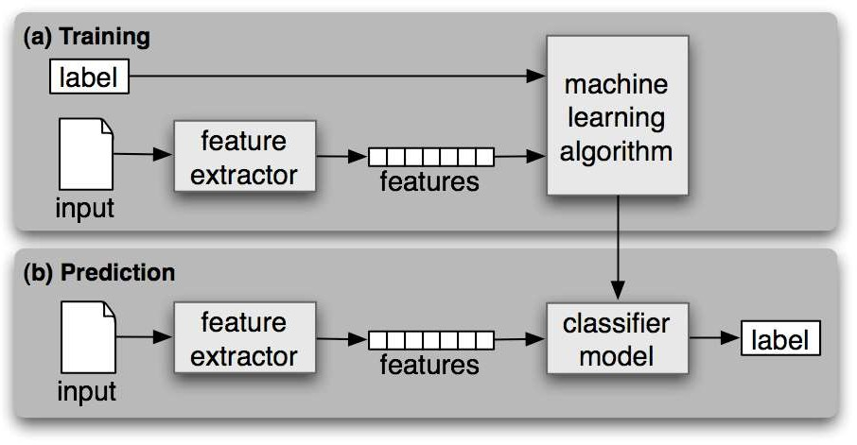
Work Flow

Slide 8
Related Fields
data
mining
control theory
statistics
machine
learning
decision theory
information theory
cognitive science
databases
psychological models
evolutionary
models
neuroscience
Machine learning is primarily concerned with the accuracy and effectiveness of the computer system.

Slide 9
Terminology
Features
The number of features or distinct traits that can be used to describe
each item in a quantitative manner.
Samples
A sample is an item to process (e.g. classify). It can be a document, a picture, a sound, a video, a row in database or CSV file, or whatever you can describe with a fixed set of quantitative traits.
Feature vector
is an n-dimensional vector of numerical features that represent some
object.
Feature extraction
Preparation of feature vector
transforms the data in the high-dimensional space to a space of
fewer dimensions.
Training/Evolution set
Set of data to discover potentially predictive relationships.

Slide 10
ML KEYNOTES THROUGHOUT TIME
Top-Down Approach
Shakey the Robot
A solution for big business
Man vs machine
WW2
1943
1950
1956
1968
1969
1973
1981
1990
1997
Robot Story
2001: A Space Odyssey
The AI Winter
Back to Bottom-up
War Machines
Are machine intelligent now?
Dance Bots
2002
2005
2008
2010
2011
2014
Roomba
Google’s Speech Recognition
Man vs machine 21st century

Slide 11
Types of Machine Learning Problems
Supervised
Unsupervised
Reinforcement

Slide 12
Types of Machine Learning Problems
Learn through examples of which we know the desired output (what we want to predict).
Supervised
Is this a cat or a dog?
Are these emails spam or not?
Unsupervised
Predict the market value of houses, given the square meters, number of rooms, neighborhood, etc.
Reinforcement

Slide 13
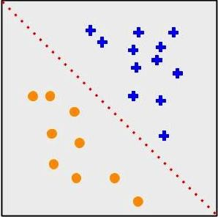
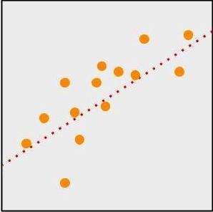
Types of Machine Learning Problems
Supervised
Classification
Output is a discrete variable (e.g., cat/dog)
Unsupervised
Regression
Output is continuous (e.g., price, temperature)
Reinforcement

Slide 14
Types of Machine Learning Problems
Supervised
There is no desired output. Learn something about the data. Latent relationships.
Unsupervised
I have photos and want to put them in 20 groups.
I want to find anomalies in the credit card usage patterns of my customers.
Reinforcement

Slide 15
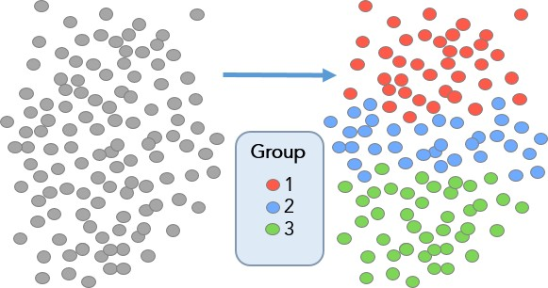
Types of Machine Learning Problems
Supervised
Useful for learning structure in the data (clustering), hidden correlations, reduce dimensionality, etc.
Unsupervised
Reinforcement

Slide 16

Types of Machine Learning Problems
Supervised
An agent interacts with an environment and watches the result of the interaction.
Environment gives feedback via a positive or negative reward signal.
Unsupervised
Reinforcement

Slide 17
Steps to Solve a Machine Learning Problem
Data Ingestion
Data Understanding & Merging
Data Exploratory Analysis
Feature Engineering
Data Pre-processing
Data Model Building
Probability Thresholding
Data Model Evaluation
Data Model Performance

Slide 18
Data Gathering
Might depend on human work
Manual labeling for supervised learning.
Domain knowledge. Maybe even experts.
May come for free, or “sort of”
E.g., Machine Translation.
The more the better: Some algorithms need large amounts of data to be useful (e.g., neural networks).
The quantity and quality of data dictate the model accuracy

Slide 19
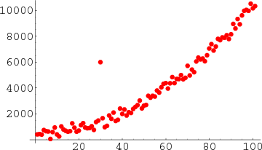
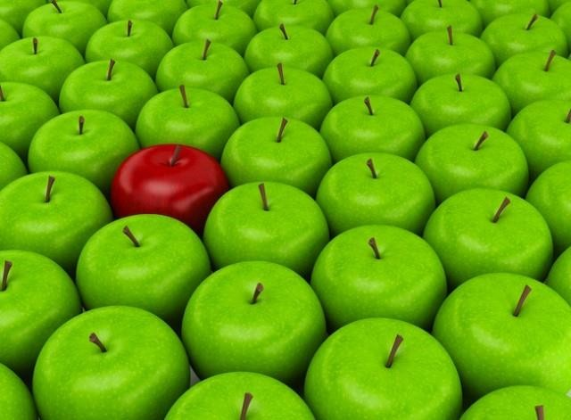
Data Preprocessing
Is there anything wrong with the data?
Missing values
Outliers
Bad encoding (for text)
Wrongly-labeled examples
Biased data
Do I have many more samples of one class than the rest?
Need to fix/remove data?

Slide 20
Feature Engineering
What is a feature?
A feature is an individual measurable property of a phenomenon being observed
Our inputs are represented by a set of features.
To classify spam email, features could be:
Number of words that have been ch4ng3d
like this.
Language of the email (0=English, 1=Spanish)
Number of emojis
Buy ch34p drugs from the ph4rm4cy now :) :) :)
Feature
engineering
(2, 0, 3)

Slide 21
…contd. Feature Engineering
Extract more information from existing data, not adding “new” data per-se
Making it more useful
With good features, most algorithms can learn faster It can be an art
Requires thought and knowledge of the data Two steps:
Variable transformation (e.g., dates into weekdays, normalizing)
Feature creation (e.g., n-grams for texts, if word is capitalized to detect names, etc.)

Slide 22
Algorithm Selection & Training
Supervised
Unsupervised
Linear classifier
Naive Bayes
Support Vector Machines (SVM)
Decision Tree
Random Forests
k-Nearest Neighbors
Neural Networks (Deep learning)
PCA
t-SNE
k-means
DBSCAN
Reinforcement
SARSA–λ
Q-Learning

Slide 23




Algorithm Selection & Training
Goal of training: making the correct prediction as often as possible
Incremental improvement:
Predict
Adjust
Use of metrics for evaluating performance and comparing solutions
Hyperparameter tuning: more an art than a science

Slide 24















Making Predictions
Training Phase
Labels
Machine Learning model
Feature extraction
Samples
Features
Prediction Phase
Input
Feature extraction
Features
Trained classifier
Label

